Slide 1
Experımental Research
Chapter Thirteen

Slide 2

Uniqueness of Experimental Research

Slide 3
Uniqueness of Experimental Research
Experimental Research is unique since it is:
Only type of research that attempts to influence a particular variable
Best type of research for testing hypotheses about cause-and-effect relationships
Experimental Research looks at the following variables:
Independent variable (treatment)
Dependent variable (outcome)

Slide 4
Characteristics of Experimental Research
The researcher manipulates the independent variable.
They decide the nature and the extent of the treatment.
After the treatment has been administered, researchers observe or measure the groups receiving the treatments to see if they differ.
Experimental research enables researchers to go beyond description and prediction, and attempt to determine what caused effects.

Slide 5
Randomization
Random assignment is similar but not identical to random selection.
Random assignment means that every individual who is participating in the experiment has an «equal chance» of being assigned to any of the experimental or control groups.
Random selection means that every member of a population has an equal chance of being selected to be a member of the sample.
Three things occur with random assignments of subjects:
It takes place before the experiment begins
Process of assigning the groups takes place
Groups should be equivalent

Slide 6
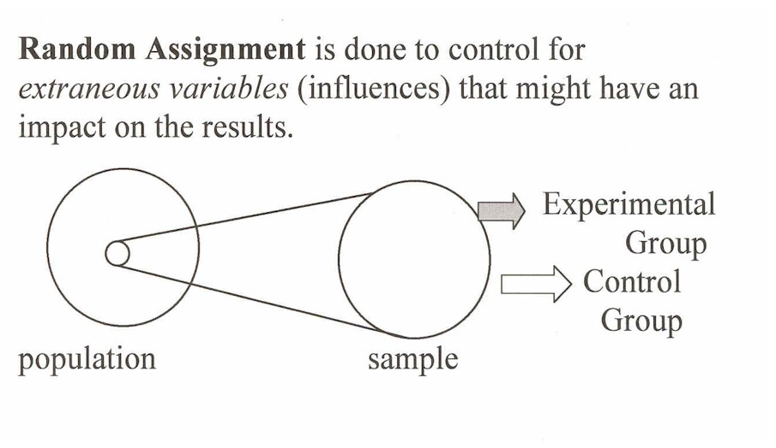
Random Assignment

Slide 7
Control of Extraneous Variables
The researcher has the ability to control many aspects of an experiment.
It is the responsibility of the researcher to control for possible threats to internal validity.
This is done by ensuring that all subject characteristics that might affect the study are controlled.
Independent Variable
Experimental variable
Predictor
Dependent Variable
Outcome
Criterion
Response
Extraneous
variables

Slide 8

How to Eliminate Threats due to Subject Characteristics?
Randomization
Hold certain variables constant
Build the variable into the design
Matching
Use subjects as their own control
Analysis of Covariance (ANCOVA)

Slide 9
Weak Experimental Designs
The following designs are considered weak since they do not have built-in controls for threats to internal validity
The One-Shot Case Study
A single group is exposed to a treatment and its effects are assessed
The One-Group-Pretest-Posttest Design
Single group is measured both before and after a treatment exposure
The Static-Group Comparison Design
Two intact groups receive two different treatments

Slide 10
Example of a One-Shot Case Study Design
X
NEW REGISTRATION SYTEM
O
Turn-Over Rates
(Dependent Variable)

Slide 11
Example of a One-Group Pretest-Posttest Design
O
Pretest:
Survey on How to Use
New Registration System
O
Posttest:
Survey on How to Use
New Registration System
X
Treatment:
2 hours of training

Slide 12
Example of a Static-Group Comparison Design
X1
NEW REGISTRATION SYTEM
O1
Turn-Over Rates
X2
OLD REGISTRATION SYTEM
O2
Turn-Over Rates

Slide 13
True Experimental Designs
The essential ingredient of a true experiment is random assignment of subjects to treatment groups
Random assignments is a powerful tool for controlling threats to internal validity
The Randomized Posttest-only Control Group Design
Both groups receiving different treatments
The Randomized Pretest-Posttest Control Group Design
Pretest is included in this design
The Randomized Solomon Four-Group Design
Four groups used, with two pre-tested and two not pre-tested

Slide 14
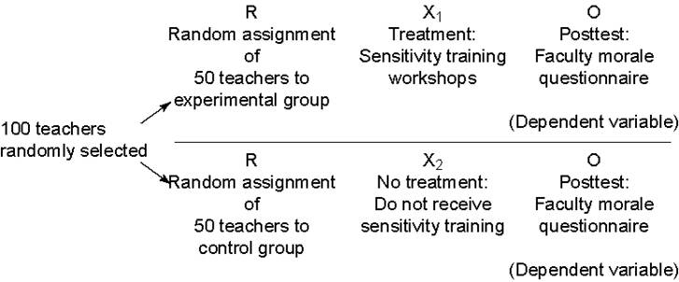
Example of a Randomized Posttest-Only Control Group Design

Slide 15
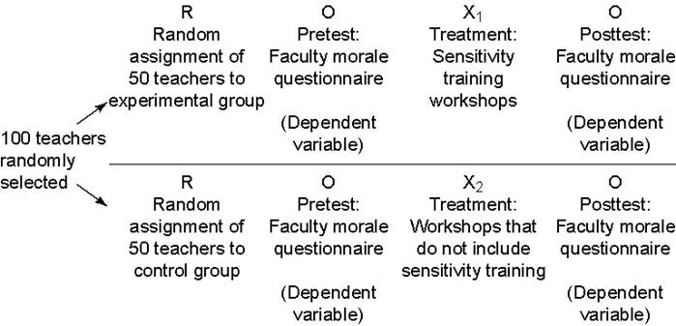
Example of a Randomized Pretest-Posttest Control Group Design
users

Slide 16
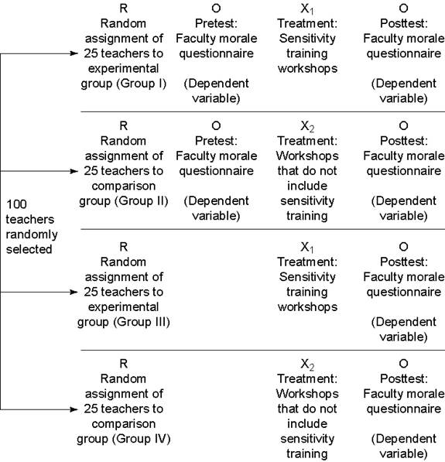
Example of a Randomized Solomon Four-Group Design

Slide 17
Random Assignment with Matching
To increase the likelihood that groups of subjects will be equivalent, pairs of subjects may be matched on certain variables.
Members of matched groups are then assigned to experimental or control groups.
Matching can be mechanical or statistical.

Slide 18
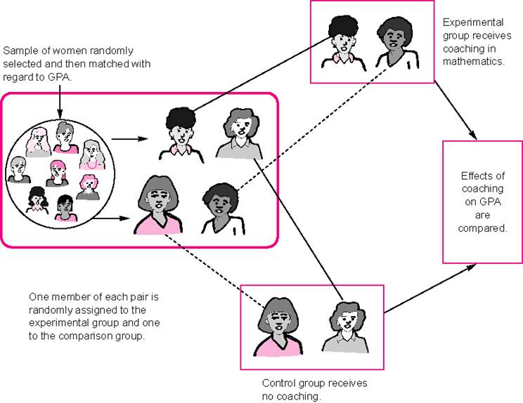
A Randomized Posttest-Only Control Group Design, Using Matched Subjects

Slide 19
Mechanical and Statistical Matching
Mechanical matching is a process of pairing 2 persons whose scores on a particular variable are similar.
Statistical matching does not necessitate a loss of subjects, nor does it limit the number of matching variables.
Each subject is given a “predicted” score on the dependent variable, based on the correlation between the dependent variable and the variable on which the subjects are being matched.
The difference between the predicted and actual scores for each individual is then used to compare experimental and control groups.

Slide 20
Quasi-Experimental Designs
Quasi-Experimental Designs do not include the use of random assignments but use other techniques to control for threats to internal validity:
The Matching-Only Design
Similar except that no random assignment occurs
Counterbalanced Design
All groups are exposed to all treatments but in a different order
Time-Series Design
Involves repeated measures over time, both before and after treatment

Slide 21
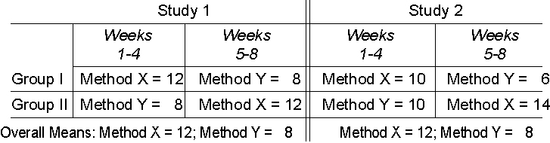
Results (Means) from a Study Using a Counterbalanced Design

Slide 22
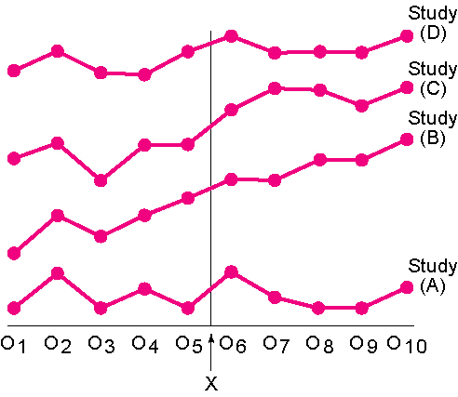
Possible Outcome Patterns in a Time-Series Design

Slide 23
Factorial Designs
Factorial Designs extend the number of relationships that may be examined in an experimental study.
They are modifications of either the posttest-only control group or pretest-posttest control group designs which permit the investigation of additional independent variables.
They also allow a researcher to study the interaction of an independent variable with one or more other variables (moderator variable).

Slide 24
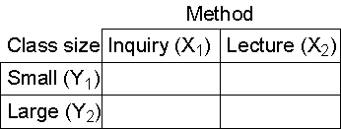
Using a Factorial Design to Study Effects of Method and Class Size on Achievement

Slide 25
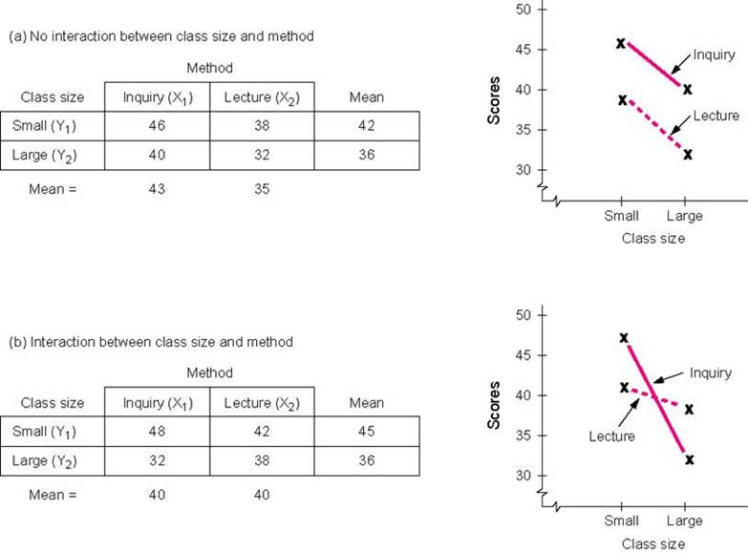
Illustration of Interaction and No Interaction in a 2 by 2 Factorial Design

Slide 26
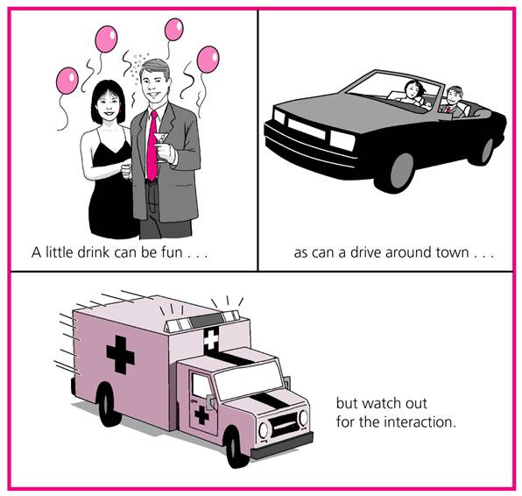
(Figure 13.12)

Slide 27
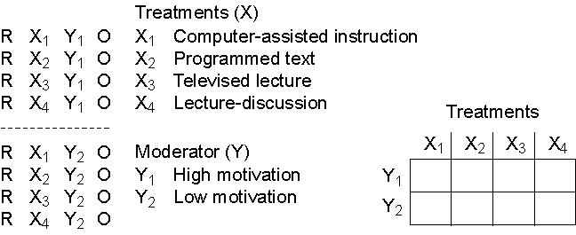
Example of a 4 by 2 Factorial Design

Slide 28
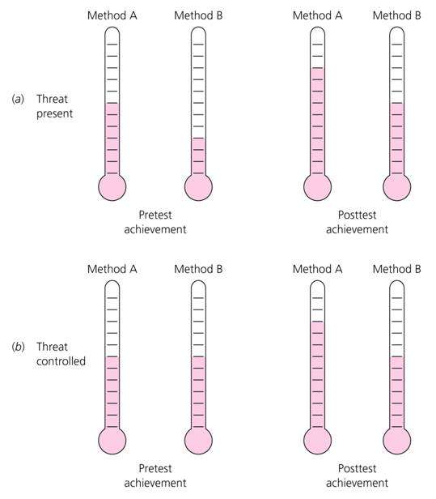
(Figure 13.14)

Slide 29
Effectiveness of Experimental Designs in Controlling Threats to Internal Validity (Table 13.1)
KEY: (++) = strong control, threat unlikely to occur; (+) = some control, threat may possibly occur;
(–) = weak control, threat likely to occur; (?) = can’t determine; (NA) = threat does not apply
Subject Instru- Data Collec-
Charac- Morta- Loca- ment tor Charac- Data Col- Matur- Atti- Regres- Implemen-
Design teristics lity tion Decay teristics lector Bias Testing History ation tudinal sion tation
One-shot case
study – – – (NA) – – (NA) – – – – –
One group pre-
posttest – ? – – – – – – – – – –
Static group
comparison – – – + – – + ? + – – –
Randomized post-
test-only control
group ++ + – + – – ++ + ++ – ++ –
Randomized pre-
post-test control
group ++ + – + – – + + ++ – ++ –
Solomon four-
group ++ ++ – + – – ++ + ++ – ++ –
Randomized
posttest only
control group
with matched
subjects ++ + – + – – ++ + ++ – ++ –
Matching-only
pre-posttest
control group + + – + – – + + + – + –
Counterbalanced ++ ++ – + – – – ++ ++ ++ ++ –
Time-series ++ – + _ – – – – + – ++ –
Factorial with
randomization ++ ++ – ++ – – + + ++ – ++ –
Factorial without
randomization ? ? – ++ – – + + + – ? –

Slide 30
Controlling Threats to Internal Validity
Subject Characteristics
Mortality
Location
Instrument decay
Data Collector Characteristics
Data Collector bias
Testing
History
Maturation
Attitudinal
Regression
Implementation
The above must be controlled to reduce threats to internal validity

